Slide 1
GAS POWER CYCLES

Slide 2
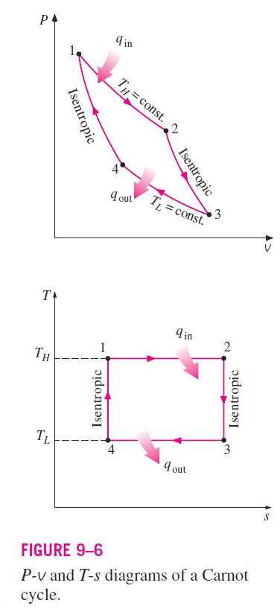
THE CARNOT CYCLE AND ITS VALUE IN ENGINEERING
The Carnot cycle is composed of four totally reversible processes:
Isothermal heat addition
Isentropic expansion
Isothermal heat rejection
Isentropic compression
The P-v and T-s diagrams of a Carnot cycle are replotted in Fig. 9–6.

Slide 3
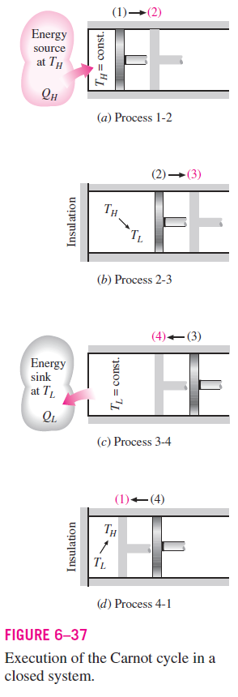
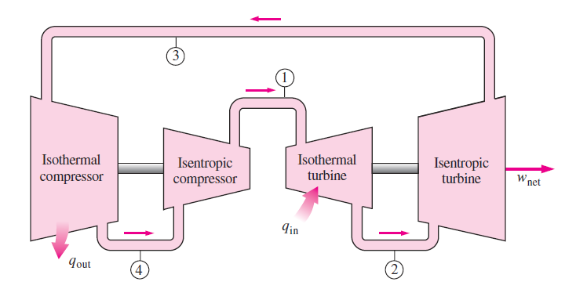

The Carnot cycle can be executed in a closed system (a piston–cylinder device , as shown in Fig. 6–37) or a steady-flow system (utilizing two turbines and two compressors, as shown in Fig. 9–7), and either a gas or a vapor can be utilized as the working fluid.

Slide 4

The Carnot cycle is the most efficient cycle that can be executed between a heat source at temperature T_{H} and a sink at temperature T_{L}, and its thermal efficiency is expressed as:
Reversible isothermal heat transfer is very difficult to achieve because it would require very large heat exchangers and it would take a very long time (a power cycle in a typical engine is completed in a fraction of a second).
Therefore, it is not practical to build an engine that would operate on a cycle that closely approximates the Carnot cycle.
The real value of the Carnot cycle comes from its being a standard against which the actual cycles can be compared.

Slide 5
The thermal efficiency of the Carnot cycle is a function of the sink and source temperatures only (Eq. 9–2) ,
The thermal efficiency relation for the Carnot cycle conveys an important message that is equally applicable to both ideal and actual cycles:
“Thermal efficiency increases with an increase in the average temperature at which heat is supplied to the system or with a decrease in the average temperature at which heat is rejected from the system.”
However, The source and sink temperatures that can be used in practice are not without limits.
The highest temperature in the cycle is limited by the maximum temperature that the components of the heat engine, such as the piston or the turbine blades, can withstand.
The lowest temperature is limited by the temperature of the cooling medium utilized in the cycle such as a lake, a river, or the atmospheric air.

Slide 6
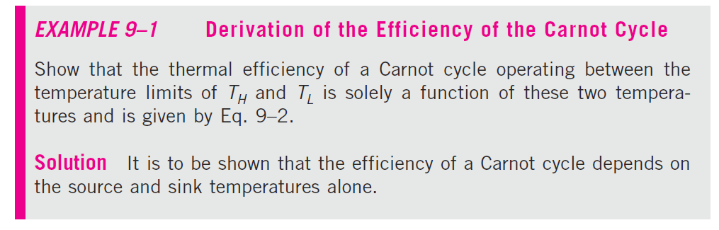
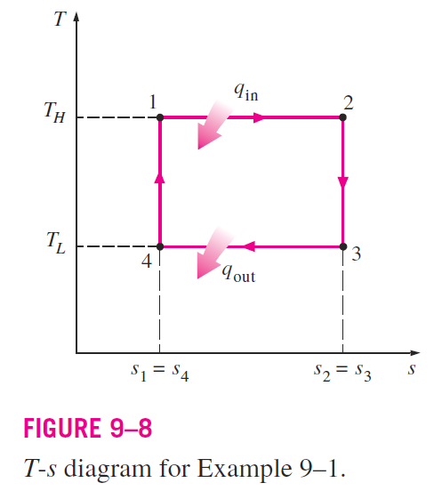
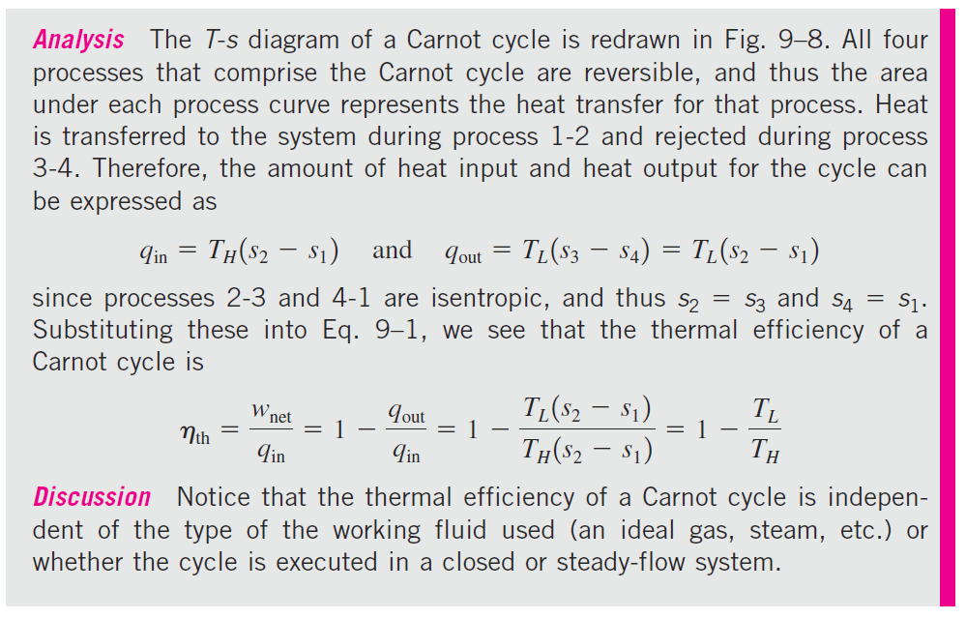
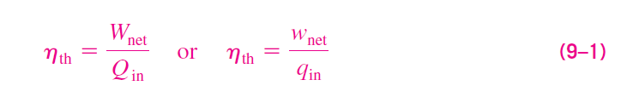

Slide 7
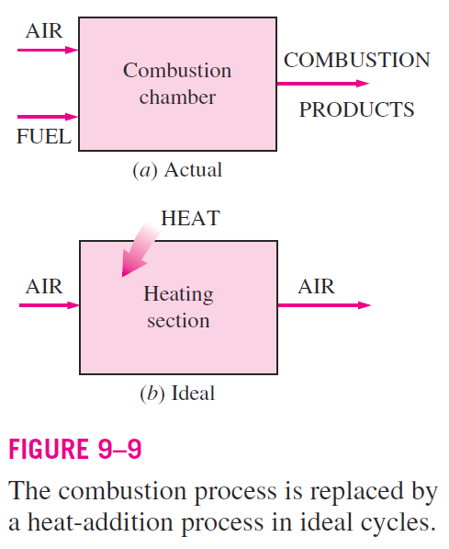
AIR-STANDARD ASSUMPTIONS
In gas power cycles, the working fluid remains a gas throughout the entire cycle.
Spark-ignition engines, diesel engines, and conventional gas turbines are familiar examples of devices that operate on gas cycles.
In all these engines, energy is provided by burning a fuel within the system boundaries. That is, they are internal combustion engines.
Because of this combustion process, the composition of the working fluid changes from air and fuel to combustion products during the cycle.
However, considering that air is predominantly nitrogen that undergoes hardly any chemical reactions in the combustion chamber, the working fluid closely always resembles air .

Slide 8
Even though internal combustion engines operate on a mechanical cycle (the piston returns to its starting position at the end of each revolution), the working fluid does not undergo a complete thermodynamic cycle.
It is thrown out of the engine at some point in the cycle (as exhaust gases) instead of being returned to the initial state.
Working on an open cycle is the characteristic of all internal combustion engines.

Slide 9
The actual gas power cycles are rather complex.
To reduce the analysis to a manageable level, we utilize the following approximations, commonly known as the air-standard assumptions:
The working fluid is air, which continuously circulates in a closed loop and always behaves as an ideal gas.
All the processes that make up the cycle are internally reversible.
The combustion process is replaced by a heat-addition process from an external source (Fig. 9–9).
4. The exhaust process is replaced by a heat-rejection process that restores the working fluid to its initial state.

Slide 10
Another assumption that is often utilized to simplify the analysis even more is that air has constant specific heats whose values are determined at room temperature (25°C, or 77°F).
When this assumption is utilized, the air-standard assumptions are called the cold-air-standard assumptions.
A cycle for which the air-standard assumptions are applicable is frequently referred to as an air-standard cycle.

Slide 11
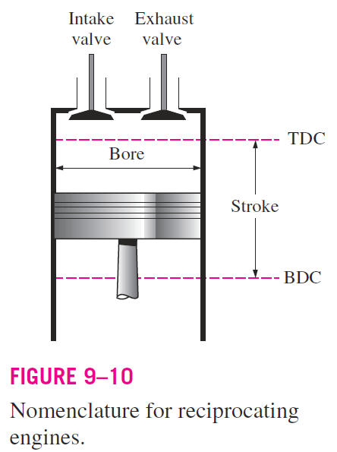
AN OVERVIEW OF RECIPROCATING ENGINES
Despite its simplicity, the reciprocating engine (basically a piston–cylinder device) is one of the rare inventions that has proved to be very versatile and to have a wide range of applications.
It is the powerhouse of most automobiles, trucks, light aircraft, ships, and electric power generators, as well as many other devices.
The basic components of a reciprocating engine are shown in Fig. 9–10.
The piston reciprocates in the cylinder between two fixed positions called the top dead center (TDC)—the position of the piston when it forms the smallest volume in the cylinder—and the bottom dead center (BDC)—the position of the piston when it forms the largest volume in the cylinder.
The distance between the TDC and the BDC is the largest distance that the piston can travel in one direction, and it is called the stroke of the engine.

Slide 12
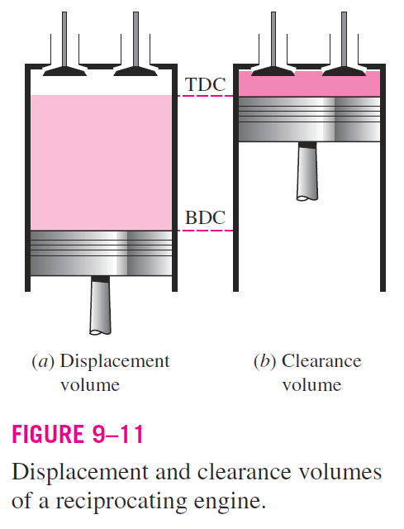

The diameter of the piston is called the bore.
The air or air–fuel mixture is drawn into the cylinder through the intake valve, and the combustion products are expelled from the cylinder through the exhaust valve.
The minimum volume formed in the cylinder when the piston is at TDC is called the clearance volume (Fig. 9 –11).
The volume displaced by the piston as it moves between TDC and BDC is called the displacement volume.
The ratio of the maximum volume formed in the cylinder to the minimum (clearance) volume is called the compression ratio r of the engine:
Notice that the compression ratio is a volume ratio and should not be confused with the pressure ratio.

Slide 13
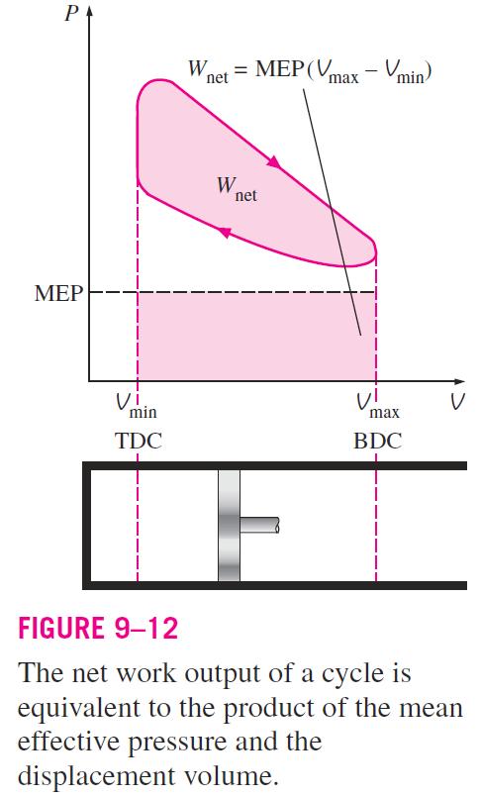
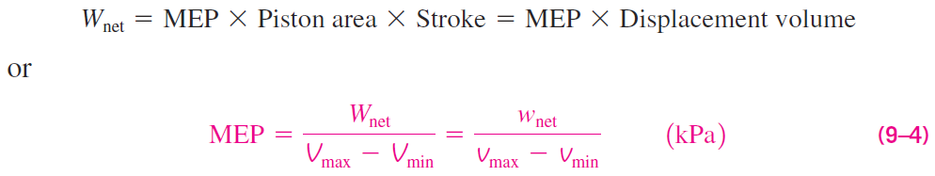
Another term frequently used in conjunction with reciprocating engines is the mean effective pressure (MEP).
It is a fictitious pressure that, if it acted on the piston during the entire power stroke, would produce the same amount of net work as that produced during the actual cycle (Fig. 9–12).
The mean effective pressure can be used as a parameter to compare the performances of reciprocating engines of equal size.
The engine with a larger value of MEP delivers more net work per cycle and thus performs better.

Slide 14
Reciprocating engines are classified as:
Spark-ignition (SI) engines
Compression-ignition (CI) engines
depending on how the combustion process in the cylinder is initiated.
In SI engines, the combustion of the air–fuel mixture is initiated by a spark plug.
In CI engines, the air–fuel mixture is self-ignited as a result of compressing the mixture above its self-ignition temperature.

Slide 15
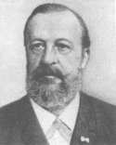
OTTO CYCLE: THE IDEAL CYCLE FOR SPARK-IGNITION ENGINES
The Otto cycle is the ideal cycle for spark-ignition reciprocating engines.
It is named after Nikolaus A. Otto, who built a successful four-stroke engine in 1876 in Germany using the cycle proposed by Frenchman de Rochas in 1862.
In most spark-ignition engines, the piston executes four complete strokes (two mechanical cycles) within the cylinder, and the crankshaft completes two revolutions.
These engines are called four-stroke internal combustion engines.

Slide 16
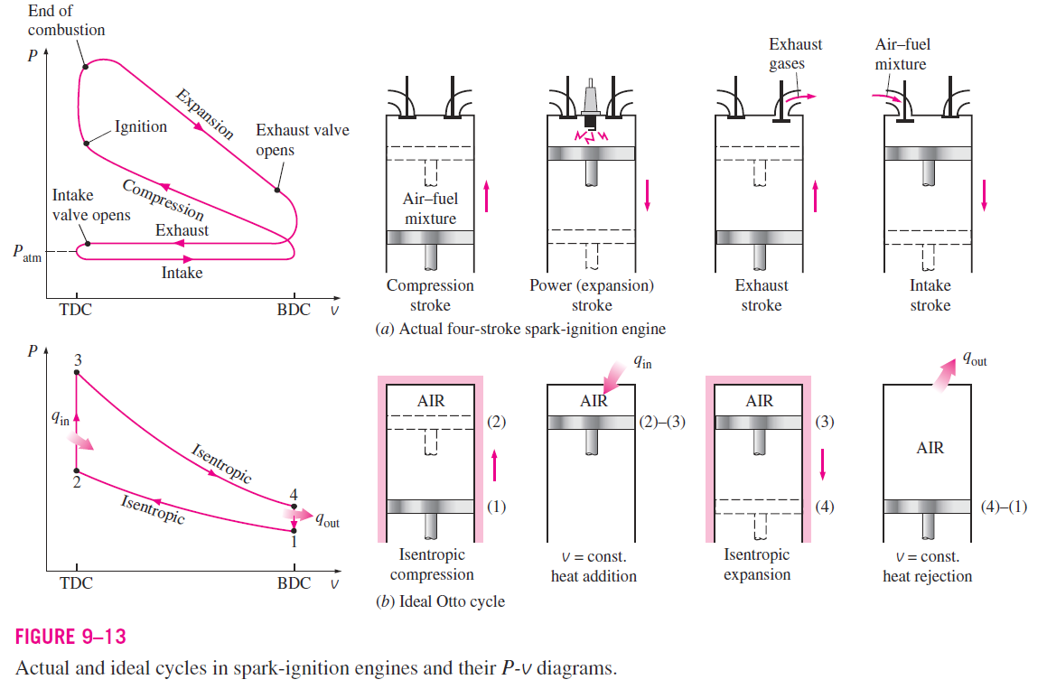
A schematic of each stroke as well as a P-v diagram for an actual four-stroke spark-ignition engine is given in Fig. 9–13(a).

Slide 17
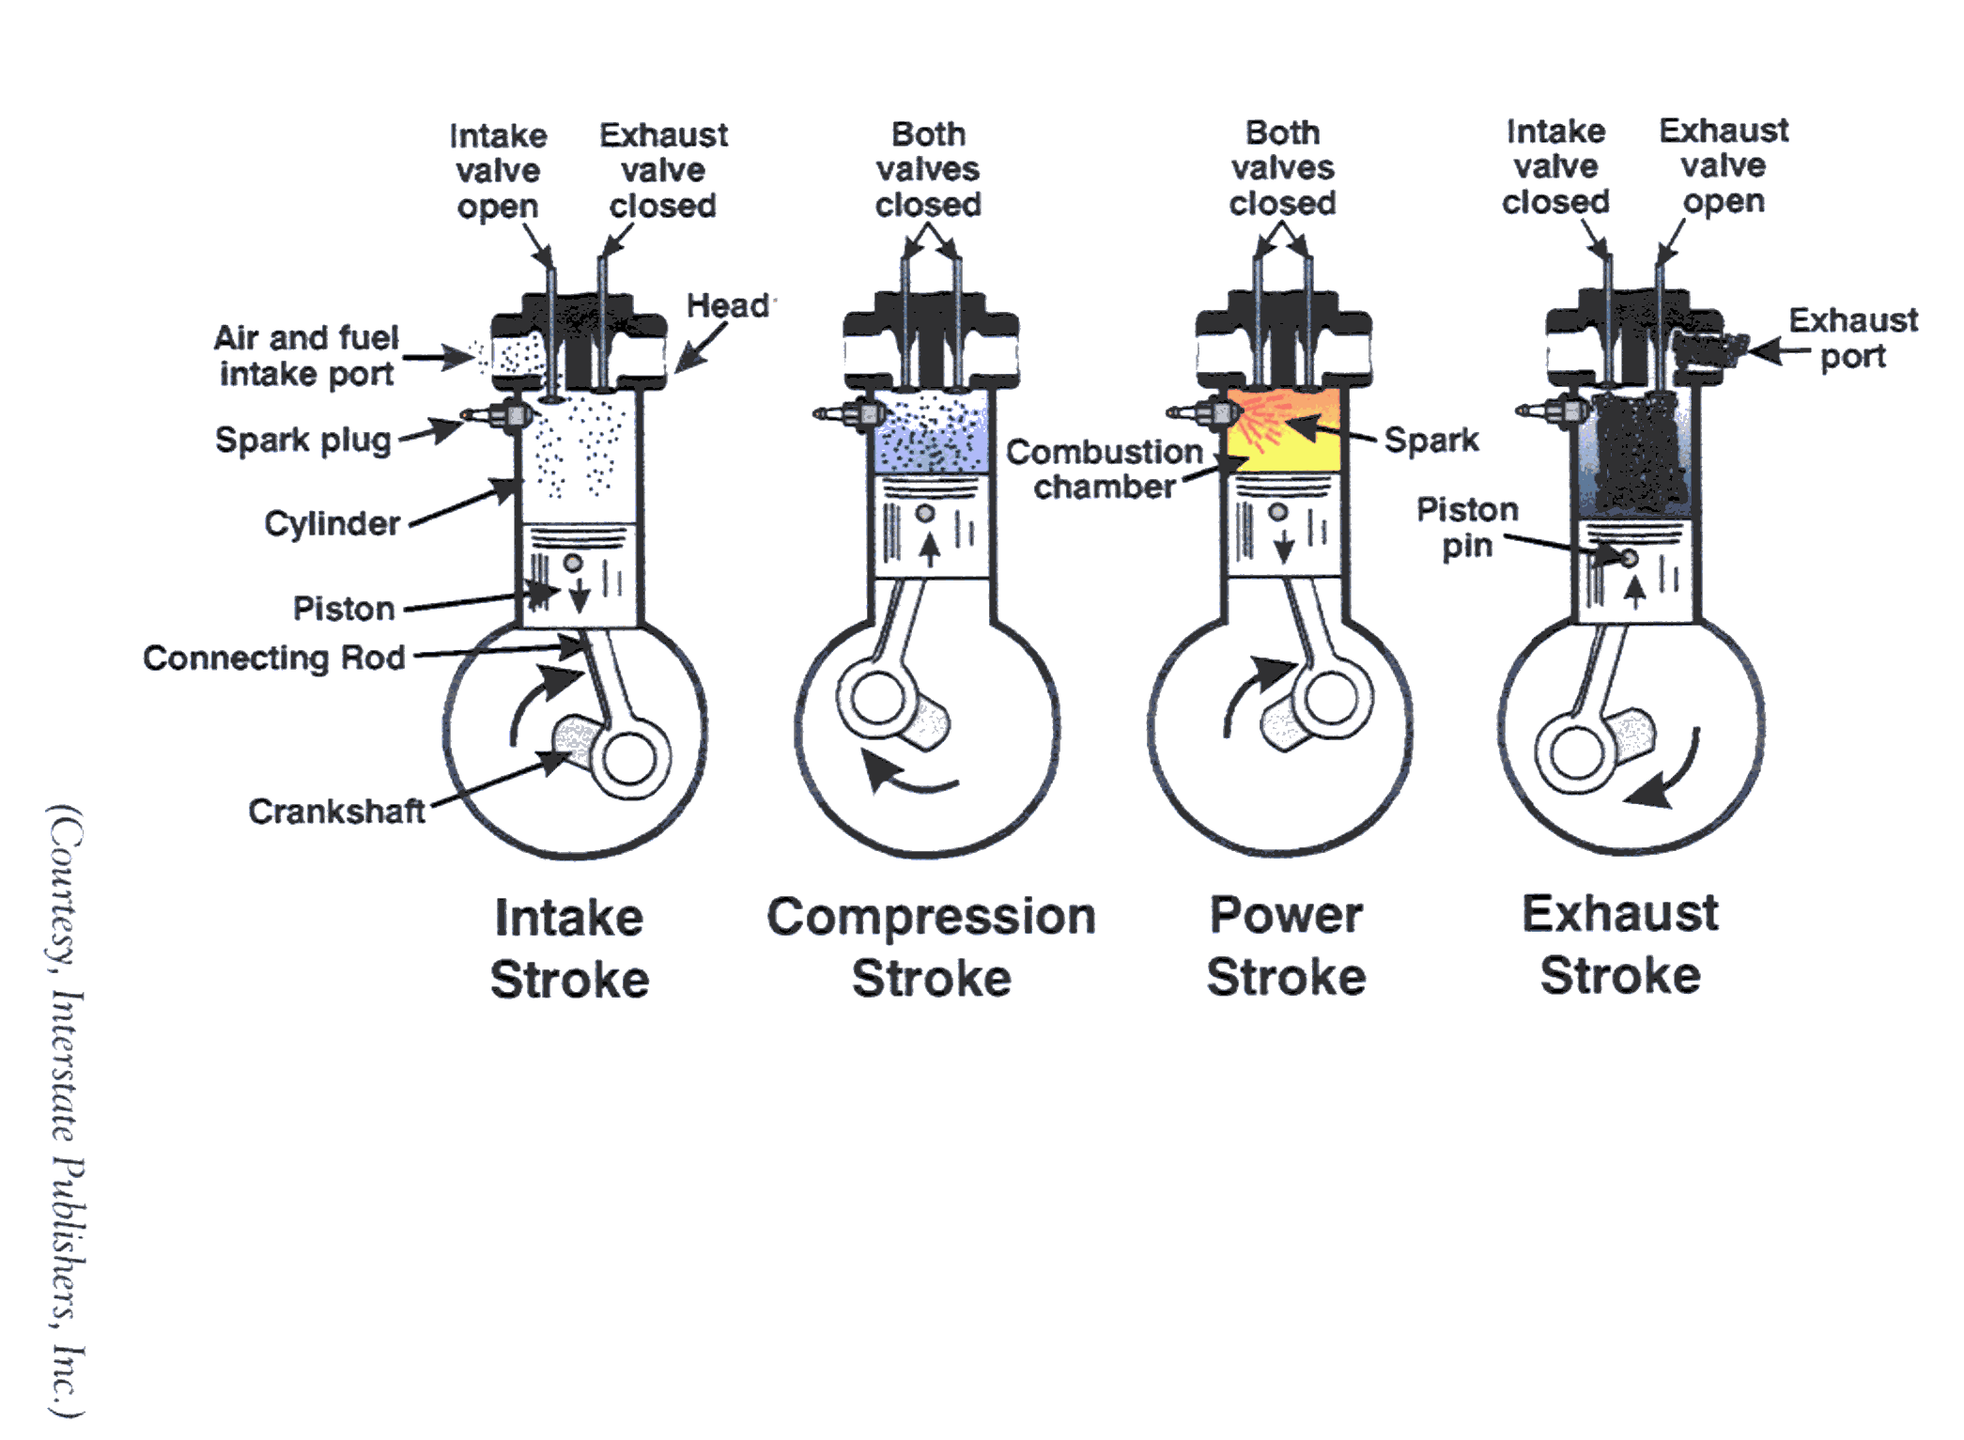

Slide 18
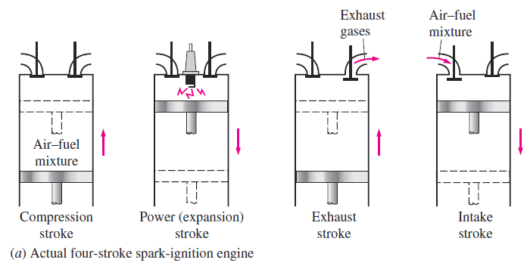
Initially, both the intake and the exhaust valves are closed, and the piston is at its lowest position (BDC).
During the compression stroke, the piston moves upward, compressing the air–fuel mixture.
Shortly before the piston reaches its highest position (TDC), the spark plug fires and the mixture ignites, increasing the pressure and temperature of the system.
The high-pressure gases force the piston down, which in turn forces the crankshaft to rotate, producing a useful work output during the expansion or power stroke.

Slide 19
At the end of this stroke, the piston is at its lowest position (the completion of the first mechanical cycle), and the cylinder is filled with combustion products.
Now the piston moves upward one more time, purging the exhaust gases through the exhaust valve (the exhaust stroke), and down a second time, drawing in fresh air–fuel mixture through the intake valve (the intake stroke).
Notice that the pressure in the cylinder is slightly above the atmospheric value during the exhaust stroke and slightly below during the intake stroke.

Slide 20
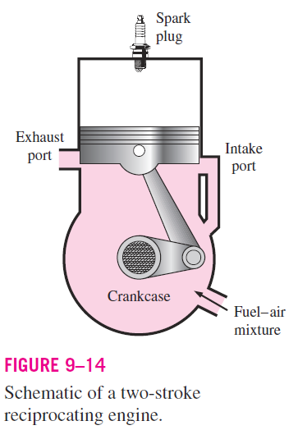
In two-stroke engines, all four functions described above are executed in just two strokes: the power stroke and the compression stroke.
In these engines, the crankcase is sealed, and the outward motion of the piston is used to slightly pressurize the air–fuel mixture in the crankcase, as shown in Fig. 9–14.
Also, the intake and exhaust valves are replaced by openings in the lower portion of the cylinder wall.
During the latter part of the power stroke, the piston uncovers first the exhaust port, allowing the exhaust gases to be partially expelled, and then the intake port, allowing the fresh air–fuel mixture to rush in and drive most of the remaining exhaust gases out of the cylinder.
This mixture is then compressed as the piston moves upward during the compression stroke and is subsequently ignited by a spark plug.

Slide 21

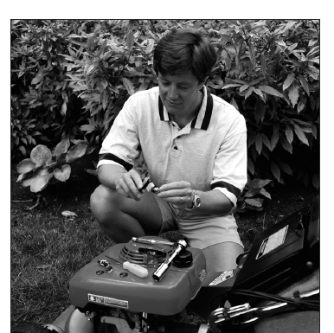

The two-stroke engines are generally less efficient than their four-stroke counterparts because of the incomplete expulsion of the exhaust gases and the partial expulsion of the fresh air–fuel mixture with the exhaust gases.
However, they are relatively simple and inexpensive, and they have high power-to-weight and power-to-volume ratios, which make them suitable for applications requiring small size and weight such as for motorcycles, chain saws, and lawn mowers (Fig. 9–15).

Slide 22
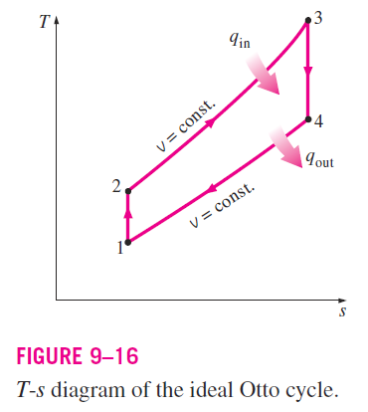
The thermodynamic analysis of the actual four-stroke or two-stroke cycles described is not a simple task.
However, the analysis can be simplified significantly if the air-standard assumptions are utilized.
The resulting cycle, which closely resembles the actual operating conditions, is the ideal Otto cycle.
It consists of four internally reversible processes:
1-2 Isentropic compression
2-3 Constant-volume heat addition
3-4 Isentropic expansion
4-1 Constant-volume heat rejection
The T-s diagram of the Otto cycle is given in Fig. 9–16.

Slide 23
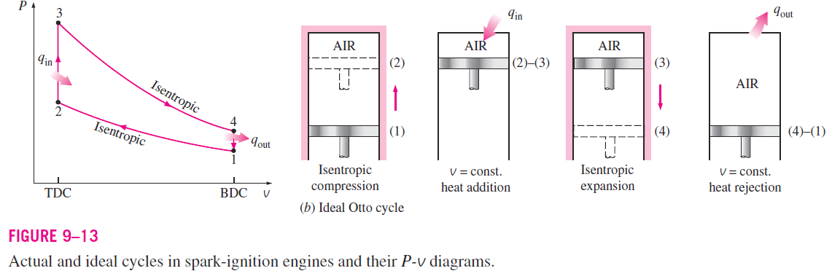
The execution of the Otto cycle in a piston–cylinder device together with a P-v diagram is illustrated in Fig. 9–13b.

Slide 24

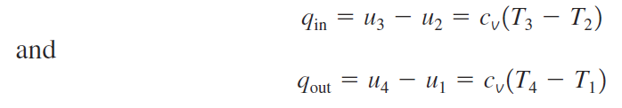
The Otto cycle is executed in a closed system, and disregarding the changes in kinetic and potential energies, the energy balance for any of the processes is expressed, on a unit-mass basis, as
No work is involved during the two heat transfer processes since both take place at constant volume.
Therefore, heat transfer to and from the working fluid can be expressed as

Slide 25
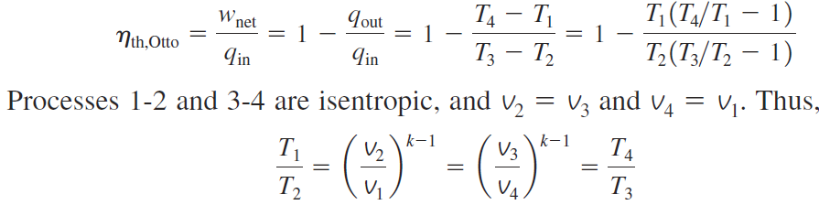
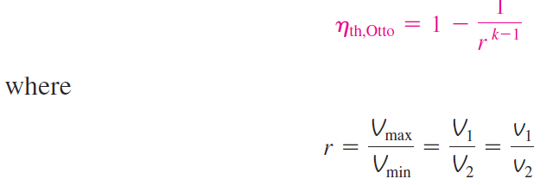
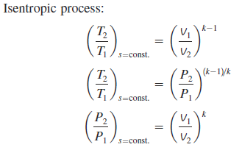
Then the thermal efficiency of the ideal Otto cycle under the cold air standard assumptions becomes
Substituting these equations into the thermal efficiency relation and simplifying give
is the compression ratio of engine and k is the specific heat ratio c_{p} /c_{v} of the working fluid.

Slide 26
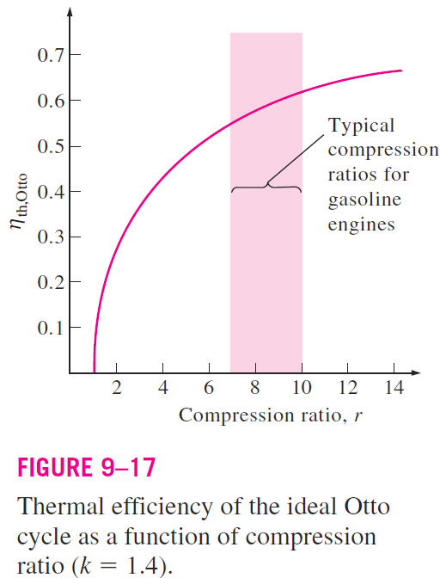
Above equation shows that under the cold-air-standard assumptions, the thermal efficiency of an ideal Otto cycle depends on the compression ratio of the engine and the specific heat ratio of the working fluid.
The thermal efficiency of the ideal Otto cycle increases with both the compression ratio and the specific heat ratio.
This is also true for actual spark-ignition internal combustion engines.
A plot of thermal efficiency versus the compression ratio is given in Fig. 9–17 for k 1.4, which is the specific heat ratio value of air at room temperature.
For a given compression ratio, the thermal efficiency of an actual spark-ignition engine is less than that of an ideal Otto cycle because of the irreversibilities, such as friction, and other factors such as incomplete combustion.

Slide 27
We can observe from Fig. 9–17 that the thermal efficiency curve is rather steep at low compression ratios but flattens out starting with a compression ratio value of about 8.
Therefore, the increase in thermal efficiency with the compression ratio is not as pronounced at high compression ratios.
Also, when high compression ratios are used, the temperature of the air–fuel mixture rises above the autoignition temperature of the fuel (the temperature at which the fuel ignites without the help of a spark), causing an early and rapid burn of the fuel.
This premature ignition of the fuel, called autoignition, produces an audible noise, which is called engine knock.
Notes:
Flammable and inflammable do not mean the same thing. If something is flammable it means it can be set fire to, such as a piece of wood. However, inflammable means that a substance is capabble of bursting into flames without the need for any ignition
End gas definition. The last part of the fuel-air mixture that has been introduced into the cylinder , but has not yet been consumed in the normal flame-front reaction.

Slide 28
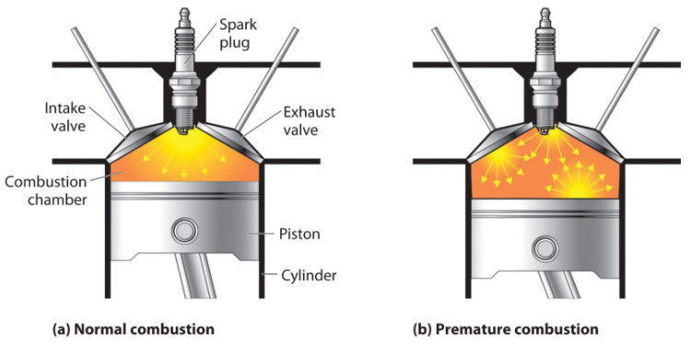
Autoignition in spark-ignition engines cannot be tolerated because it hurts performance and can cause engine damage.
The requirement that autoignition not be allowed places an upper limit on the compression ratios that can be used in spark ignition internal combustion engines.

Slide 29
Improvement of the thermal efficiency of gasoline engines by utilizing higher compression ratios (up to about 12) without facing the autoignition problem has been made possible by using gasoline blends that have good antiknock characteristics, such as gasoline mixed with tetraethyl lead.
Tetraethyl lead had been added to gasoline since the 1920s because it is an inexpensive method of raising the octane rating, which is a measure of the engine knock resistance of a fuel.
Leaded gasoline, however, has a very undesirable side effect: it forms compounds during the combustion process that are hazardous to health and pollute the environment.
In an effort to combat air pollution, the government adopted a policy in the mid-1970s that resulted in the eventual phase-out of leaded gasoline.

Slide 30
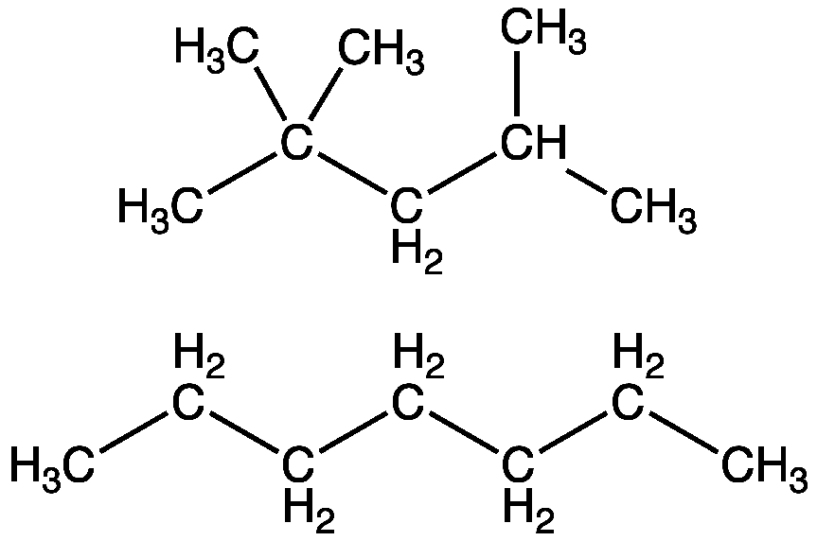
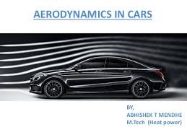
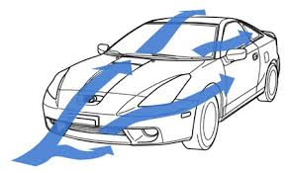
Unable to use lead, the refiners developed other techniques to improve the antiknock characteristics of gasoline.
Most cars made since 1975 have been designed to use unleaded gasoline, and the compression ratios had to be lowered to avoid engine knock.
The ready availability of high-octane fuels made it possible to raise the compression ratios again in recent years.
Also, owing to the improvements in other areas (reduction in overall automobile weight, improved aerodynamic design, etc.), today’s cars have better fuel economy and consequently get more miles per gallon of fuel.
This is an example of how engineering decisions involve compromises, and efficiency is only one of the considerations in final design.
2,2,4-Trimethylpentane (iso-octane) (upper) has an octane rating of 100, whereas n-heptane has an octane rating of 0.

Slide 31
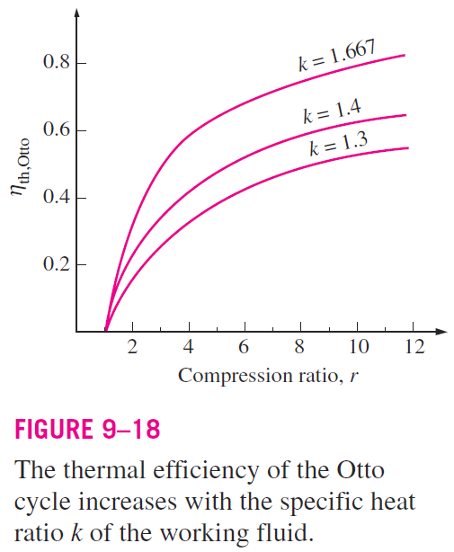
The second parameter affecting the thermal efficiency of an ideal Otto cycle is the specific heat ratio k.
For a given compression ratio, an ideal Otto cycle using a monatomic gas (such as argon or helium, k = 1.667) as the working fluid will have the highest thermal efficiency.
The specific heat ratio k, and thus the thermal efficiency of the ideal Otto cycle, decreases as the molecules of the working fluid get larger (Fig. 9–18).
At room temperature it is 1.4 for air, 1.3 for carbon dioxide, and 1.2 for ethane.
The working fluid in actual engines contains larger molecules such as carbon dioxide, and the specific heat ratio decreases with temperature, which is one of the reasons that the actual cycles have lower thermal efficiencies than the ideal Otto cycle.
The thermal efficiencies of actual spark-ignition engines range from about 25 to 30 percent.

Slide 32
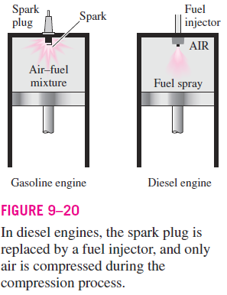
DIESEL CYCLE: THE IDEAL CYCLE FOR COMPRESSION-IGNITION ENGINES
The Diesel cycle is the ideal cycle for CI reciprocating engines.
The CI engine, first proposed by Rudolph Diesel in the 1890s, is very similar to the SI engine discussed in the last section, differing mainly in the method of initiating combustion.
In spark-ignition engines (also known as gasoline engines), the air–fuel mixture is compressed to a temperature that is below the autoignition temperature of the fuel, and the combustion process is initiated by firing a spark plug.
In CI engines (also known as diesel engines), the air is compressed to a temperature that is above the autoignition temperature of the fuel, and combustion starts on contact as the fuel is injected into this hot air.
Therefore, the spark plug and carburetor are replaced by a fuel injector in diesel engines (Fig. 9–20).

Slide 33
In gasoline engines, a mixture of air and fuel is compressed during the compression stroke, and the compression ratios are limited by the onset of autoignition or engine knock.
In diesel engines, only air is compressed during the compression stroke, eliminating the possibility of autoignition.
Therefore, diesel engines can be designed to operate at much higher compression ratios, typically between 12 and 24.
Not having to deal with the problem of autoignition has another benefit: many of the strict requirements placed on the gasoline can now be removed, and fuels that are less refined (thus less expensive) can be used in diesel engines.
The fuel injection process in diesel engines starts when the piston approaches TDC and continues during the first part of the power stroke.
Therefore, the combustion process in these engines takes place over a longer interval.

Slide 34
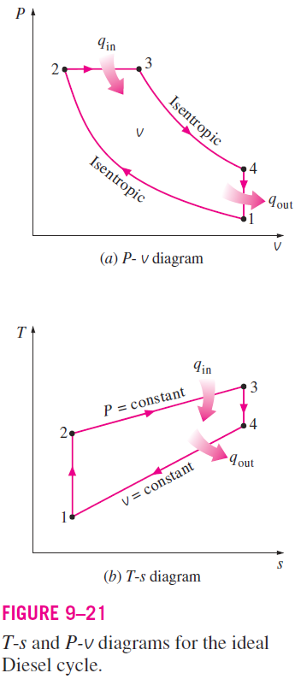
Because of this longer duration, the combustion process in the ideal Diesel cycle is approximated as a constant-pressure heat-addition process.
In fact, this is the only process where the Otto and the Diesel cycles differ.
The remaining three processes are the same for both ideal cycles.
That is, process 1-2 is isentropic compression, 3-4 is isentropic expansion, and 4-1 is constant-volume heat rejection.
The similarity between the two cycles is also apparent from the P-v and T-s diagrams of the Diesel cycle, shown in Fig. 9–21.

Slide 35
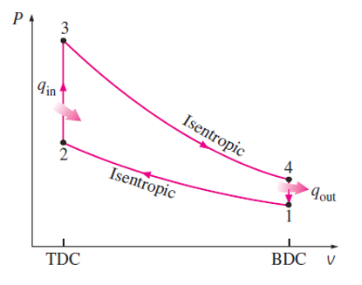
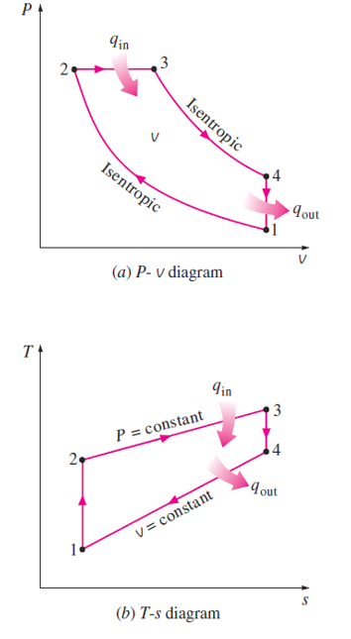
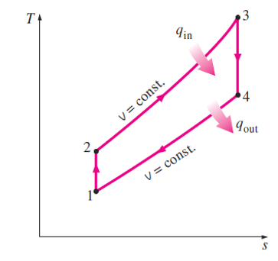
Otto Cycle
Diesel Cycle

Slide 36
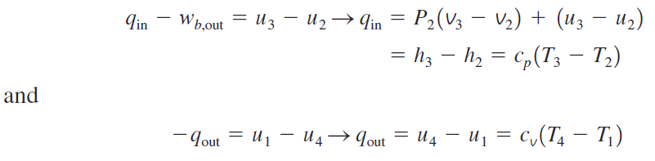

Noting that the Diesel cycle is executed in a piston–cylinder device, which forms a closed system, the amount of heat transferred to the working fluid at constant pressure and rejected from it at constant volume can be expressed as
Then the thermal efficiency of the ideal Diesel cycle under the cold-air standard assumptions becomes

Slide 37

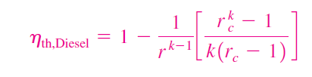
We now define a new quantity, the cutoff ratio r_{c} , as the ratio of the cylinder volumes after and before the combustion process:
Utilizing this definition and the isentropic ideal-gas relations for processes 1-2 and 3-4, we see that the thermal efficiency relation reduces to
where r is the compression ratio

Slide 38
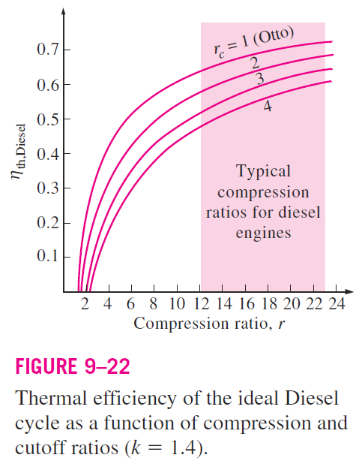

Looking at above equation carefully, one would notice that under the cold-air-standard assumptions, the efficiency of a Diesel cycle differs from the efficiency of an Otto cycle by the quantity in the brackets. This quantity is always greater than 1.
Therefore,
when both cycles operate on the same compression ratio.
Also, as the cutoff ratio decreases, the efficiency of the Diesel cycle increases (Fig. 9–22).

Slide 39
Remember, though, that diesel engines operate at much higher compression ratios and thus are usually more efficient than the spark-ignition (gasoline) engines.
The diesel engines also burn the fuel more completely since they usually operate at lower revolutions per minute and the air–fuel mass ratio is much higher than spark-ignition engines.
Thermal efficiencies of large diesel engines range from about 35 to 40 percent.
The higher efficiency and lower fuel costs of diesel engines make them attractive in applications requiring relatively large amounts of power, such as in locomotive engines, emergency power generation units, large ships, and heavy trucks.
As an example of how large a diesel engine can be, a 12- cylinder diesel engine built in 1964 by the Fiat Corporation of Italy had a normal power output of 25,200 hp (18.8 MW) at 122 rpm, a cylinder bore of 90 cm, and a stroke of 91 cm.

Slide 40
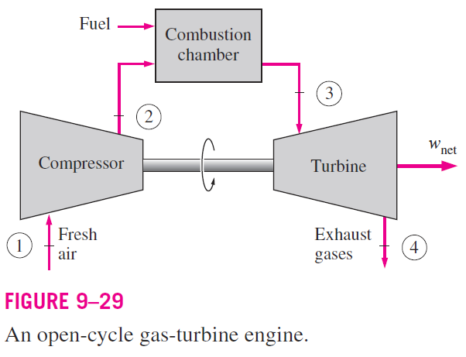
BRAYTON CYCLE: THE IDEAL CYCLE FOR GAS-TURBINE ENGINES
The Brayton cycle was first proposed by George Brayton for use in the reciprocating oil-burning engine that he developed around 1870.
Today, it is used for gas turbines only where both the compression and expansion processes take place in rotating machinery.
Gas turbines usually operate on an open cycle, as shown in Fig. 9–29.

Slide 41
Fresh air at ambient conditions is drawn into the compressor, where its temperature and pressure are raised.
The high-pressure air proceeds into the combustion chamber, where the fuel is burned at constant pressure.
The resulting high-temperature gases then enter the turbine, where they expand to the atmospheric pressure while producing power.
The exhaust gases leaving the turbine are thrown out (not recirculated), causing the cycle to be classified as an open cycle.

Slide 42
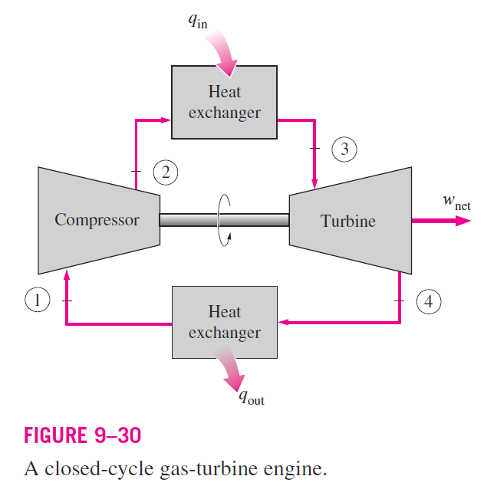
The open gas-turbine cycle described above can be modeled as a closed cycle, as shown in Fig. 9–30, by utilizing the air-standard assumptions.
Here the compression and expansion processes remain the same, but the combustion process is replaced by a constant-pressure heat-addition process from an external source,
and the exhaust process is replaced by a constant pressure heat-rejection process to the ambient air.

Slide 43
The ideal cycle that the working fluid undergoes in this closed loop is the Brayton cycle, which is made up of four internally reversible processes:
1-2 Isentropic compression (in a compressor)
2-3 Constant-pressure heat addition
3-4 Isentropic expansion (in a turbine)
4-1 Constant-pressure heat rejection

Slide 44
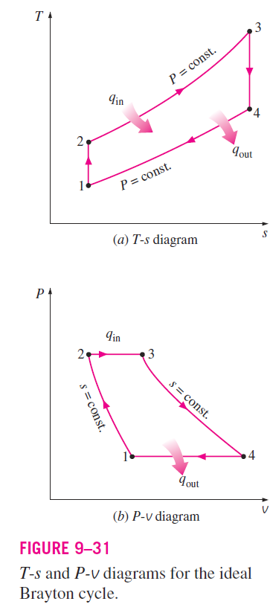
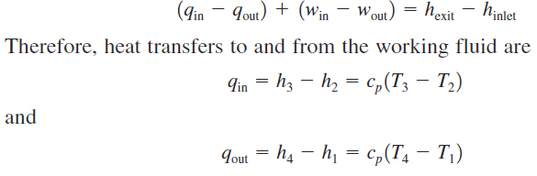
The T-s and P-v diagrams of an ideal Brayton cycle are shown in Fig. 9–31.
Notice that all four processes of the Brayton cycle are executed in steady flow devices; thus, they should be analyzed as steady-flow processes.
When the changes in kinetic and potential energies are neglected, the energy balance for a steady-flow process can be expressed, on a unit–mass basis, as

Slide 45
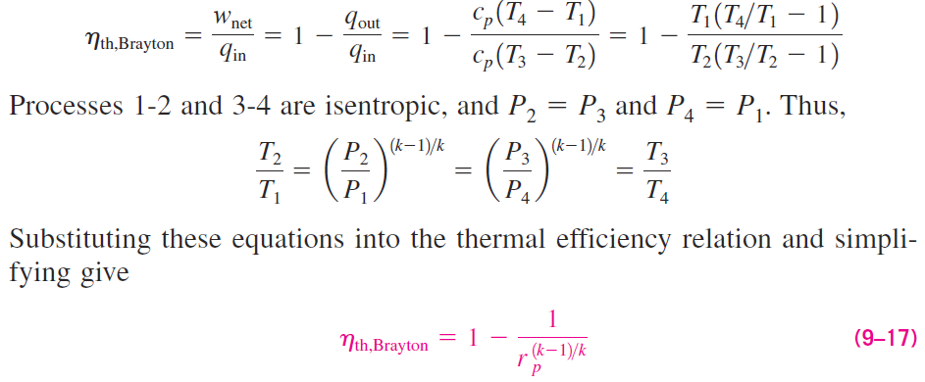
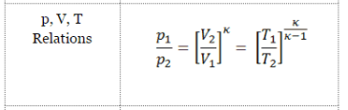

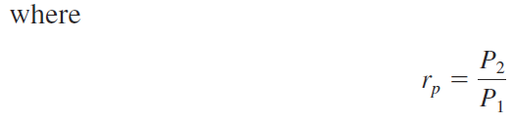
Then the thermal efficiency of the ideal Brayton cycle under the cold-air standard assumptions becomes
is the pressure ratio and k is the specific heat ratio.

Slide 46
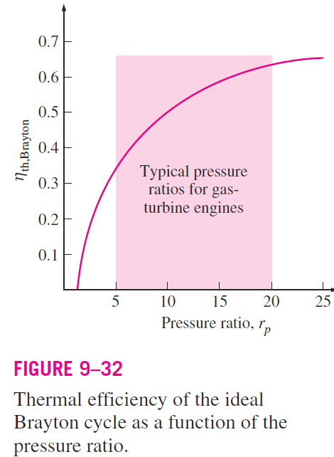
Above equation shows that under the cold-air-standard assumptions, the thermal efficiency of an ideal Brayton cycle depends on the pressure ratio of the gas turbine and the specific heat ratio of the working fluid.
The thermal efficiency increases with both of these parameters, which is also the case for actual gas turbines.
A plot of thermal efficiency versus the pressure ratio is given in Fig. 9–32 for k 1.4, which is the specific-heat-ratio value of air at room temperature.

Slide 47
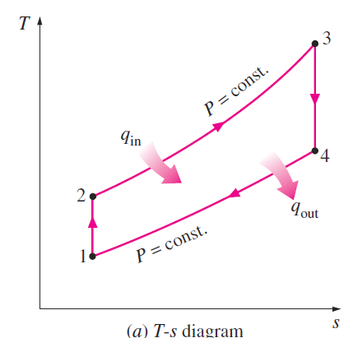
The highest temperature in the cycle occurs at the end of the combustion process (state 3), and it is limited by the maximum temperature that the turbine blades can withstand.
This also limits the pressure ratios that can be used in the cycle.

Slide 48
The air in gas turbines performs two important functions:
It supplies the necessary oxidant for the combustion of the fuel, and
It serves as a coolant to keep the temperature of various components within safe limits.
The second function is accomplished by drawing in more air than is needed for the complete combustion of the fuel.
In gas turbines, an air–fuel mass ratio of 50 or above is common.
Therefore, in a cycle analysis, treating the combustion gases as air does not cause any appreciable error.
Also, the mass flow rate through the turbine is greater than that through the compressor, the difference being equal to the mass flow rate of the fuel.
Thus, assuming a constant mass flow rate throughout the cycle yields moderate results for open-loop gas-turbine engines.

Slide 49
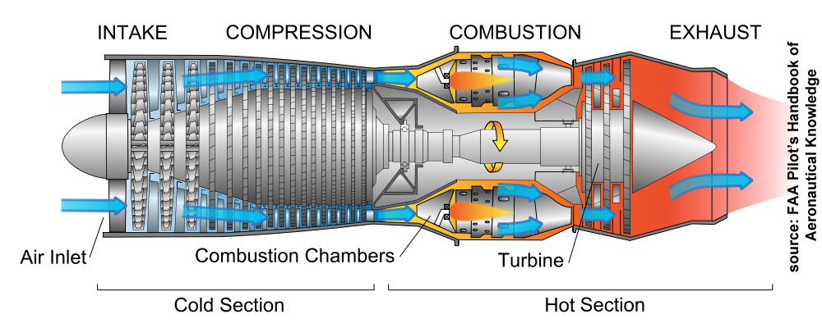
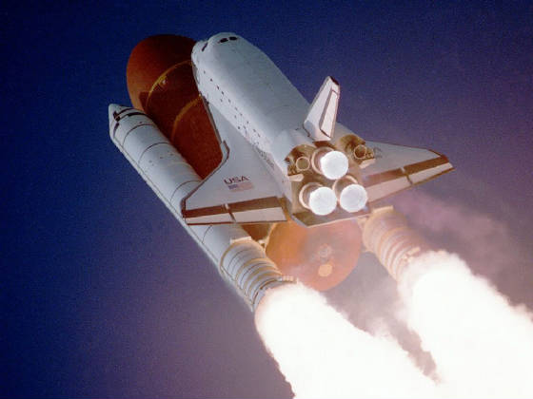

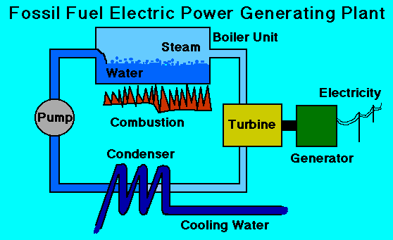
The two major application areas of gas-turbine engines are aircraft propulsion and electric power generation.
When it is used for aircraft propulsion, the gas turbine produces just enough power to drive the compressor and a small generator to power the auxiliary equipment.
The high-velocity exhaust gases are responsible for producing the necessary thrust to propel the aircraft.
Gas turbines are also used as stationary power plants to generate electricity as stand-alone units or in conjunction with steam power plants on the high-temperature side.
In these plants, the exhaust gases of the gas turbine serve as the heat source for the steam.
The gas-turbine cycle can also be executed as a closed cycle for use in nuclear power plants.
This time the working fluid is not limited to air, and a gas with more desirable characteristics (such as helium) can be used.

Slide 50



Slide 51



The majority of the Western world’s naval fleets already use gas-turbine engines for propulsion and electric power generation
The General Electric LM2500 gas turbines used to power ships have a simple-cycle thermal efficiency of 37 percent.
The General Electric WR-21 gas turbines equipped with intercooling and regeneration have a thermal efficiency of 43 percent and produce 21.6 MW (29,040 hp).
The regeneration also reduces the exhaust temperature from 600°C (1100°F) to 350°C (650°F).
Compared to steam-turbine and diesel propulsion systems, the gas turbine offers greater power for a given size and weight, high reliability, long life, and more convenient operation.
The engine start-up time has been reduced from 4 h required for a typical steam propulsion system to less than 2 min for a gas turbine.

Slide 52



Many modern marine propulsion systems use gas turbines together with diesel engines because of the high fuel consumption of simple-cycle gas-turbine engines.
In combined diesel and gas-turbine systems, diesel is used to provide for efficient low-power and cruise operation, and gas turbine is used when high speeds are needed.

Slide 53

In gas-turbine power plants, the ratio of the compressor work to the turbine work, called the back-work ratio, is very high (Fig. 9–34).
Usually more than one-half of the turbine work output is used to drive the compressor.
The situation is even worse when the isentropic efficiencies of the compressor and the turbine are low.
This is quite in contrast to steam power plants, where the back-work ratio is only a few percent.
This is not surprising, however, since a liquid is compressed in steam power plants instead of a gas
A power plant with a high back work ratio requires a larger turbine to provide the additional power requirements of the compressor.
Therefore, the turbines used in gas-turbine power plants are larger than those used in steam power plants of the same net power output.

Slide 54


THE BRAYTON CYCLE WITH REGENERATION
In gas-turbine engines, the temperature of the exhaust gas leaving the turbine is often considerably higher than the temperature of the air leaving the compressor.
Therefore, the high-pressure air leaving the compressor can be heated by transferring heat to it from the hot exhaust gases in a counter-flow heat exchanger, which is also known as a regenerator or a recuperator.
A sketch of the gas-turbine engine utilizing a regenerator and the T-s diagram of the new cycle are shown in Figs. 9–38 and 9–39, respectively.

Slide 55
The thermal efficiency of the Brayton cycle increases as a result of regeneration since the portion of energy of the exhaust gases that is normally rejected to the surroundings is now used to preheat the air entering the combustion chamber.
This, in turn, decreases the heat input (thus fuel) requirements for the same net work output.
Note, however, that the use of a regenerator is recommended only when the turbine exhaust temperature is higher than the compressor exit temperature.
Otherwise, heat will flow in the reverse direction (to the exhaust gases), decreasing the efficiency. This situation is encountered in gas-turbine engines operating at very high-pressure ratios.

Slide 56
The highest temperature occurring within the regenerator is T₄, the temperature of the exhaust gases leaving the turbine and entering the regenerator.
Under no conditions can the air be preheated in the regenerator to a temperature above this value.
Air normally leaves the regenerator at a lower temperature, T₅. In the limiting (ideal) case, the air exits the regenerator at the inlet temperature of the exhaust gases T₄.

Slide 57


Assuming the regenerator to be well insulated and any changes in kinetic and potential energies to be negligible, the actual and maximum heat transfers from the exhaust gases to the air can be expressed as
The extent to which a regenerator approaches an ideal regenerator is called the effectiveness and is defined as:

Slide 58

When the cold-air-standard assumptions are utilized, it reduces to
A regenerator with a higher effectiveness obviously saves a greater amount of fuel since it preheats the air to a higher temperature prior to combustion.
However, achieving a higher effectiveness requires the use of a larger regenerator, which carries a higher price tag and causes a larger pressure drop.

Slide 59

Therefore, the use of a regenerator with a very high effectiveness cannot be justified economically unless the savings from the fuel costs exceed the additional expenses involved.
The effectiveness of most regenerators used in practice is below 0.85.
Under the cold-air-standard assumptions, the thermal efficiency of an ideal Brayton cycle with regeneration is
Therefore, the thermal efficiency of an ideal Brayton cycle with regeneration depends on the ratio of the minimum to maximum temperatures as well as the pressure ratio.

Slide 60

The thermal efficiency is plotted in Fig. 9–40 for various pressure ratios and minimum-to-maximum temperature ratios.
This figure shows that regeneration is most effective at lower pressure ratios and low minimum-to-maximum temperature ratios.

